Slide 1
Deployment Diagrams

Slide 2
Topics to be covered
Getting Started
Terms and Concepts
Common Modeling Techniques

Slide 3
Introduction
Deployment diagrams are one of the two kinds of diagrams used in modeling the physical aspects of an object-oriented system.
A deployment diagram shows the configuration of run time processing nodes and the components that live on them.
We use deployment diagrams to model the static deployment view of a system.

Slide 4
Introduction
Deployment diagrams are essentially class diagrams that focus on a system's nodes.
Deployment diagrams are not only important for visualizing, specifying, and documenting embedded, client/server, and distributed systems, but also for managing executable systems through forward and reverse engineering.

Slide 5
Getting Started
With the UML, we use deployment diagrams to visualize the static aspect of these physical nodes and their relationships and to specify their details for construction, as shown in below figure.

Slide 6
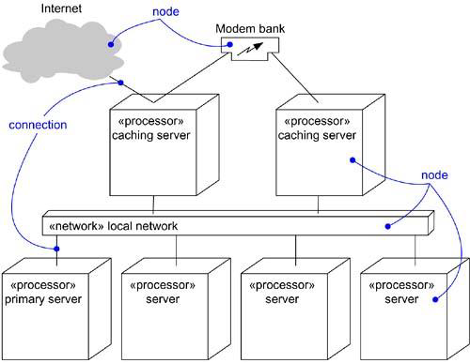
Getting Started

Slide 7
Terms and Concepts
A deployment diagram is a diagram that shows the configuration of run time processing nodes and the components that live on them.
Graphically, a deployment diagram is a collection of vertices and arcs.

Slide 8
Common Properties
A deployment diagram is just a special kind of diagram and shares the same common properties as all other diagrams - a name and graphical contents that are a projection into a model.
What distinguishes a deployment diagram from all other kinds of diagrams is its particular content.

Slide 9
Contents
Deployment diagrams commonly contain
Nodes
Dependency and association relationships
Like all other diagrams, deployment diagrams may contain notes and constraints.
Deployment diagrams may also contain components, each of which must live on some node.
Deployment diagrams may also contain packages or subsystems, both of which are used to group elements of your model into larger chunks.

Slide 10
Common Uses
When modeling the static deployment view of a system, we’ll typically use deployment diagrams in one of the three ways:
To model embedded systems.
To model client/server systems.
To model fully distributed systems.

Slide 11
Common Modeling Techniques
There are four modeling techniques are there in Deployment Diagrams
Modeling an Embedded System
Modeling a Client/Server System
Modeling a Fully Distributed System
Forward and Reverse Engineering

Slide 12
Modeling an Embedded System
To model an embedded system:
Identify the devices and nodes that are unique to your system.
Provide visual cues, especially for unusual devices, by using stereotypes.
Model the relationships among these processors and devices in a deployment diagram. Similarly, specify the relationship between components and nodes.
As necessary, expand on the intelligent devices by modeling their structure with a more detailed deployment diagram.

Slide 13
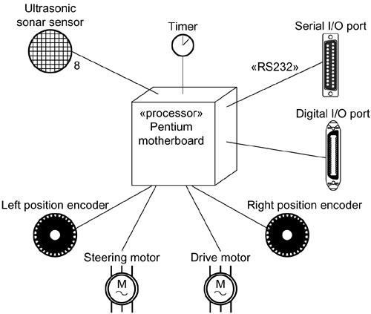
Modeling an Embedded System

Slide 14
Modeling a Client/Server System
To model a client/server system:
Identify the nodes that represent your system’s client and server processors.
Highlight those devices that are relevant to the behavior of your system.
Provide visual cues for these processors and devices via stereotyping.
Model the topology of these nodes in a deployment diagram.

Slide 15
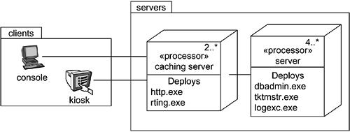
Modeling a Client/Server System

Slide 16
Modeling a Fully Distributed System
To model a fully distributed system:
Identify the system’s devices and processors as for simpler client/server systems.
If you need to reason about the performance of the system’s network or the impact of changes to the network, be sure to model these communication devices to the level of detail sufficient to make assessments.
Pay close attention to logical groupings of nodes, which you can specify by using packages.
Model these devices and processors using deployment diagrams.
If you need to focus on the dynamics of the system, introduce use case diagrams to specify the kind of behavior you are interested in, and expand on these use cases with interaction diagrams.

Slide 17
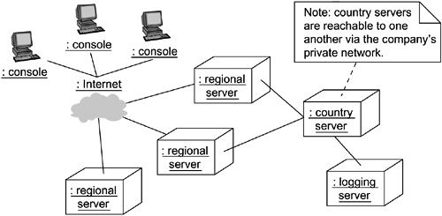
Modeling a Fully Distributed System

Slide 18
Forward and Reverse Engineering
To reverse engineer a deployment diagram,
Choose the target that you want to reverse engineer.
Choose also the fidelity of your reverse engineering.
Use a tool that walks across your system, discovering its hardware topology. Record that topology in a deployment model.
Along the way, you can use similar tools to discover the components that live on each node, which you can also record in a deployment model.
Using your modeling tools, create a deployment diagram by querying the model.

